Slide 1
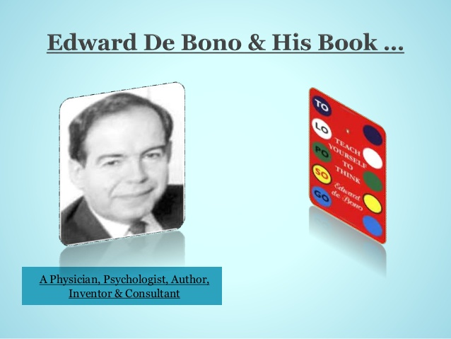
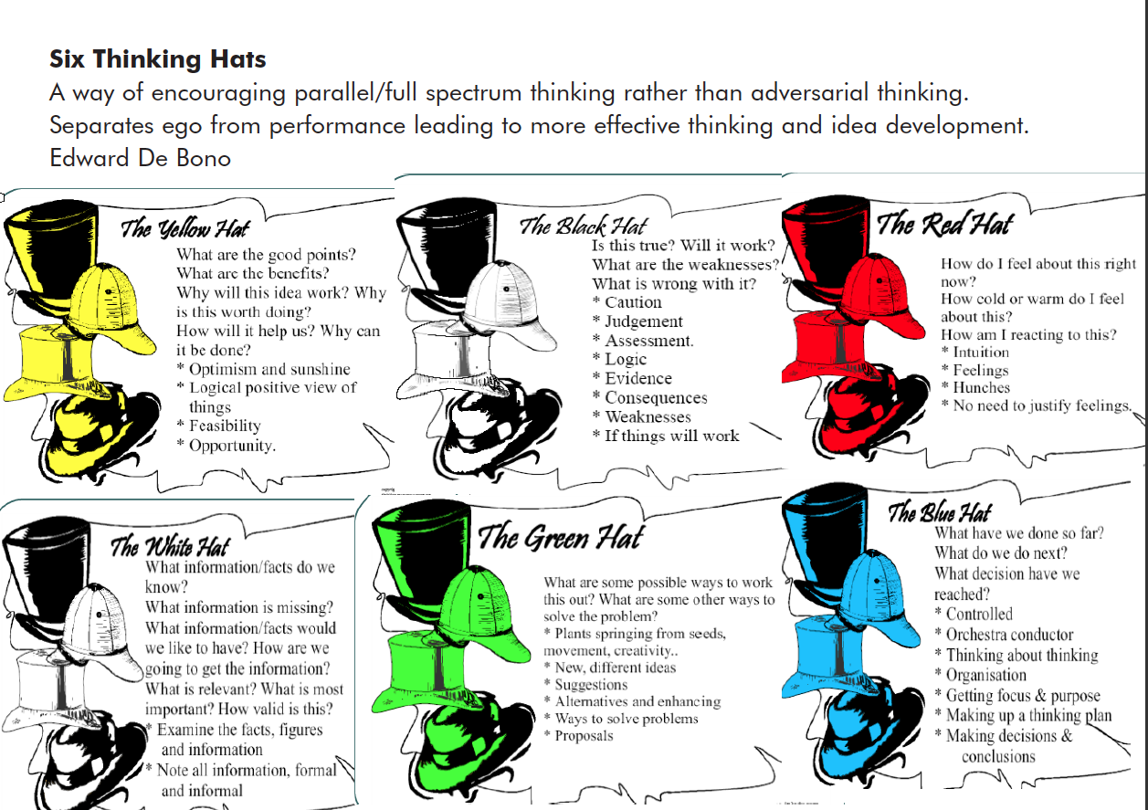
Teach Yourself To Think

Slide 2
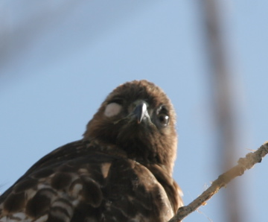
WHICH IS A BETTER HUNTER?
Partially blind hawk vs Fully functional hawk
Why?
Answer: Partially blind hawk

Slide 3
WHY WE NEED TO WORRY ABOUT THINKING
Its about perception - What can we do with petrol commodity pricing?
Thinking is not that hard – Its fun.
We need a sense of direction (Human mind is built on patterns). Lets give our brain a new pattern. – Lets teach it to think better.
You can open many doors or can stay trapped – Thinking cured my depression

Slide 4
BACKGROUND- HISTORY
The gang of three:
Socrates – Attack false/left out with truth. No constructive thinking, just attacking false ideas.
Plato – Look for truth, it exists and must be found. Believed in facisim, did not believe in relativism. Logic of finding truth, will lead to belief.
Aristotle - Taught by Plato and taught Alexander the great.

Slide 5
PAST
Logical system based on boxes.
Classify boxes, and whatever you judge and analyse put into these boxes.
Nothing can exist outside the box.
There could be no contradictions.
Analysis, judgement, criticism.
Problem
New boxes cannot be solved for, hence adaptability with creative design is needed.

Slide 6
BETTER WAY
Don’t ignore perception, everything doesn’t fit in logic
Don’t use arguments, they are biased and people want to win them
Use a possibility system
TO – LO - PO - SO – GO
TO indicates where we want to go and what we want to achieve
LO indicated what we have and what do we know now. Perception is useful
PO indicates the possibility, given what we have and what we want to achieve, lets hypothesise
SO indicates the decision points, choosing between various possibilities
GO indicates the action. What to do and what to do after

Slide 7
TO STAGE
Time spent to look for purpose of what you want to achieve is time well spent.
Be general and not always specific.
Change it,
Redefine it,
Alternate it,
Broaden it, etc.
KICK OFF MEETING. CODING – What does my function need to achieve.

Slide 8
LO STAGE
In the LO stage, it we seek to look for more information.
The information is the ingredient for the purpose.
Sometimes information will do the thinking, and other times you must seek out other information.
Use of guesses and hypothesis is fine, but caution must be maintained, overall try to aim for quality. – How to identify students based on transactional data and no student flag?
More information does not mean everything is useful. Example barking of dog is enough to detect a killer is known or unkown.

Slide 9
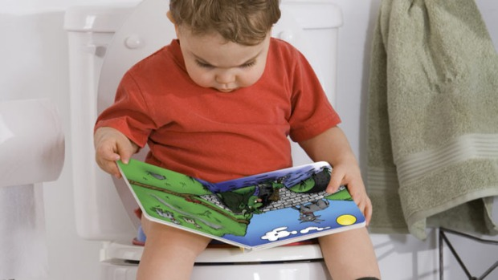
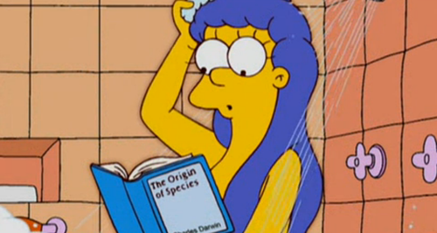
PO STAGE
We can apply routine search for alternatives. You can use past experience, etc
Be general at times, no need to define constraints.
Practice (neural focus), Forward thinking. Provocation - Example how to read book in six days. (Adjustments – Google glasses or Digital reading glasses)
After choosing idea, do a general sense check if its possible, else modify (Wear a black cap/hat)
Sometimes universe will give you the idea - (NEWTON, gravity)
I want to build an app vs I want to build an app using python

Slide 10
SO STAGE
Take the alternatives and make a single choice.
Evaluate thoroughly, if it is possible or if not, why is it not possible, make some adjustments if necessary
Best vs worst, worst amongst the best. (Black hat, Green hat)
Make a decision, should we proceed further or not (Red hat)
Ethical thinking – My feeling is not right to include M*** G*** in email

Slide 11
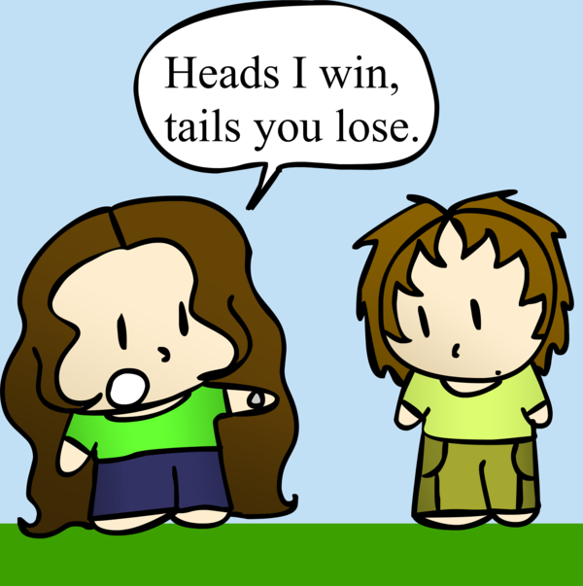
GO STAGE
This is action stage. Thinking and action are not separate.
In the implementation phase, think of how to implement it. How can you make a win - win situation. (This is hardest stage) You need all the hats
How can you get others on board to support you, your opinion and action get noticed.
Plan the resources, check the feasibility.
Learn from motivation of others and use it for your advantage.
This is where most people fail or give up. This is where you should apply most of your thinking

Slide 12
CONCLUSION
Don’t restrict your thinking
If there are many closed doors there is one open door
Conquer your fears
Any other books
Randy Paush (Last Lecture) – ‘Brick walls are there for a purpose’ (GO STAGE)

